Slide 1
United States Breweries and Beer
Varun Gopal, Roslyn Smith and David George
February 22, 2022

Slide 2
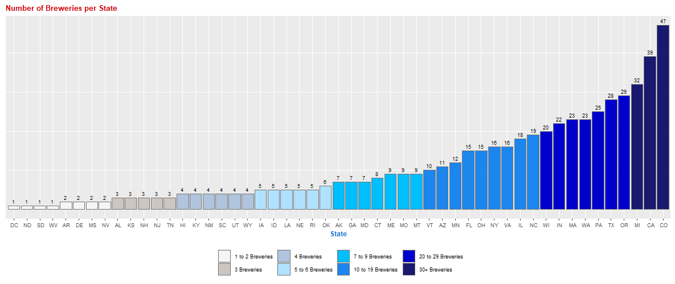
Breweries in the United States by State There is at least 1 brewery in each state in the United States. Colorado, California and Michigan lead with more than 30 breweries each. 50% of the states have 7 or less breweries with only 20% of the states have 20 or greater breweries.
Question 1 Version 1

Slide 3
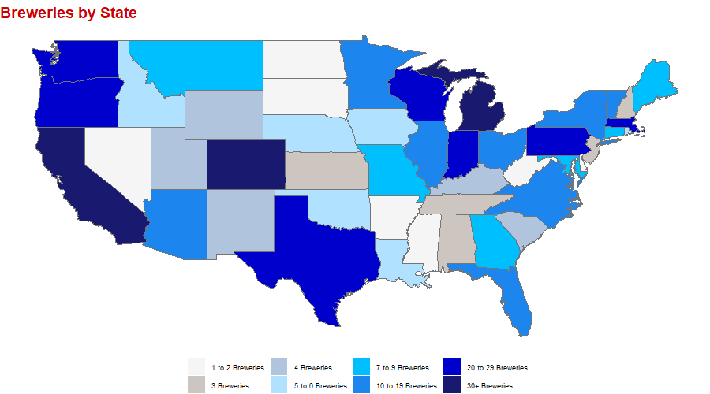
Breweries in the United States by State There is at least 1 brewery in each state in the United States. Colorado, California and Michigan lead with more than 30 breweries each. 50% of the states have 7 or less breweries with only 20% of the states have 20 or greater breweries.
Question 1 Version 2

Slide 4
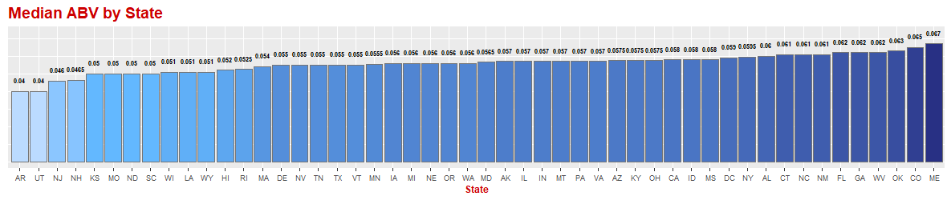
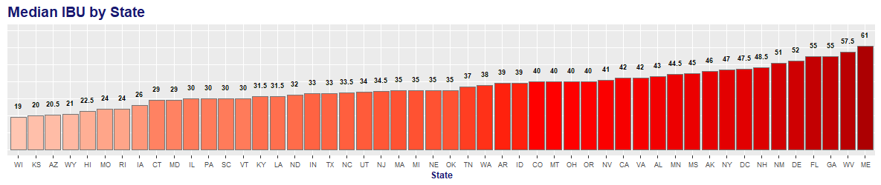
Alcohol by Volume (ABV) and International Bitterness Unit (IBU) In the data provided, of the 2,410 beers, 3% (62) of the beers did not have an ABV rating and 42% (1,005)of the beers did not have an IBU rating. Those groups are excluded from subsequent analyses and the final population that is being evaluated is 1,405 beers with all data elements.
Question 3 / 4 Version 1

Slide 5
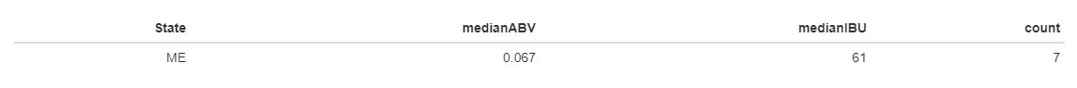
Maximum Alcoholic Beer (ABV) and Most Bitter Beer (IBU) Maine has the highest median ABV and IBU across 7 beers produced in state.
Question 5 Version 1
Print Beer names

Slide 6
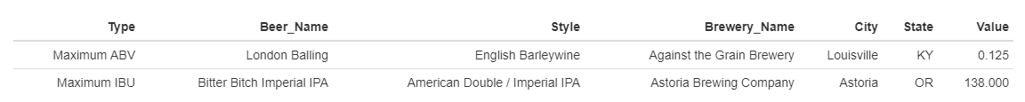
Maximum Alcoholic Beer (ABV) and Most Bitter Beer (IBU)
Question 5 Version 2
London Balling (Style: English Barleywine) brewed in Kentucky has the maximum ABV of 0.125
Bitter Bitch Imperial IPA (Style: American Double / Imperial IPA) brewed in Oregon has the maximum IBU of 138

Slide 7
Alcohol by Volume (ABV)
Question 7 Version 1
Placeholder for commentary… Comment on the summary statistics and distribution of the ABV variable.

Slide 8
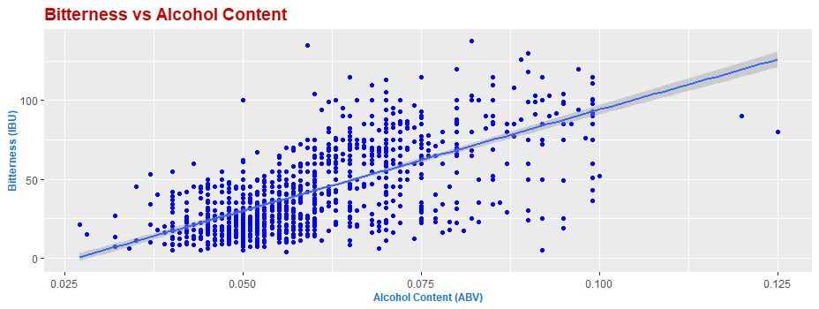
Relationship between International Bitterness Unit (IBU) and Alcohol by Volume (ABV)
Question 6 Version 1
Placeholder for commentary… Is there an apparent relationship between the bitterness of the beer and its alcoholic content? Draw a scatter plot. Make your best judgment of a relationship and EXPLAIN your answer.

